Slide 1
Amazon E-Commerce Sales

Slide 2
Summery:
By using the online E-Commerce data, we have obtained below results:
The customer with the highest number of orders came from?
The customer who spent the most money on purchases ?
The most and least profitable month in terms of sales?
Which day saw the majority of orders placed?
What country is placing the most orders?

Slide 3
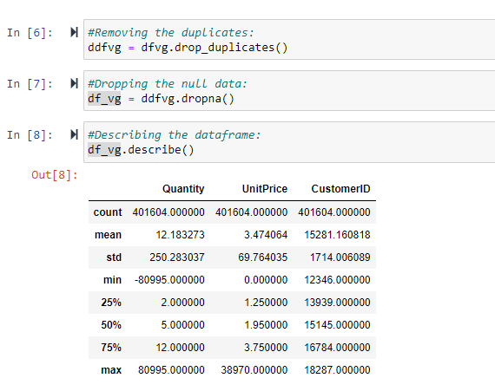
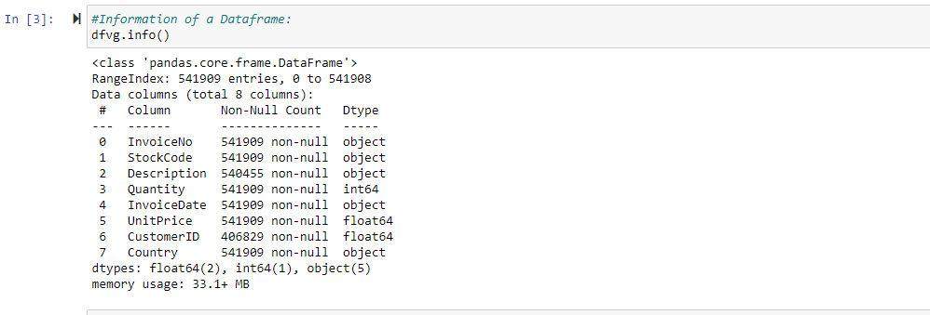
Data Information and Data Cleaning:
Dataset Consists : 541909 Records,7 Columns

Slide 4
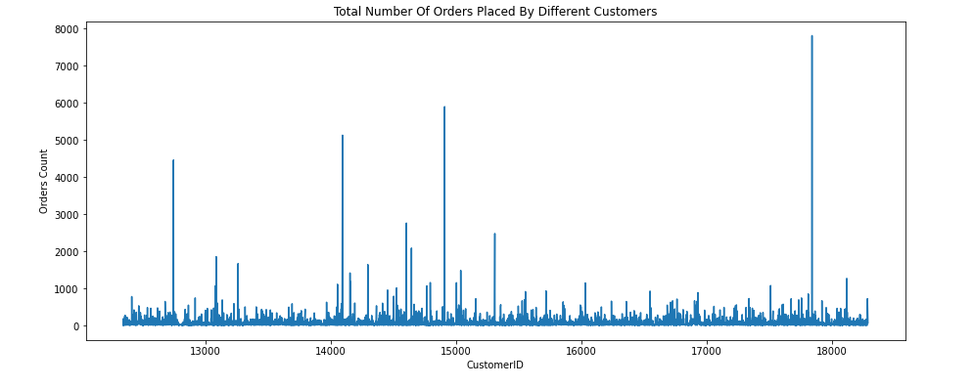
The customer with the highest number of orders came from? According to the data CustomerID >17500 belongs to United Kingdom (UK), the highest orders came from that country.

Slide 5
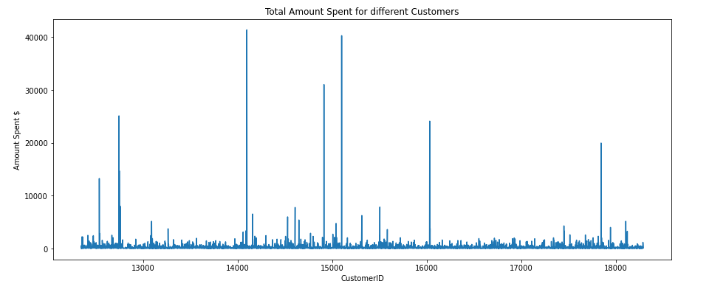
The customer who spent the most money on purchases ? The highest money spent on purchases comes from Netherlands as per the data CustomerID between14000 to 14500 belongs to that country.

Slide 6
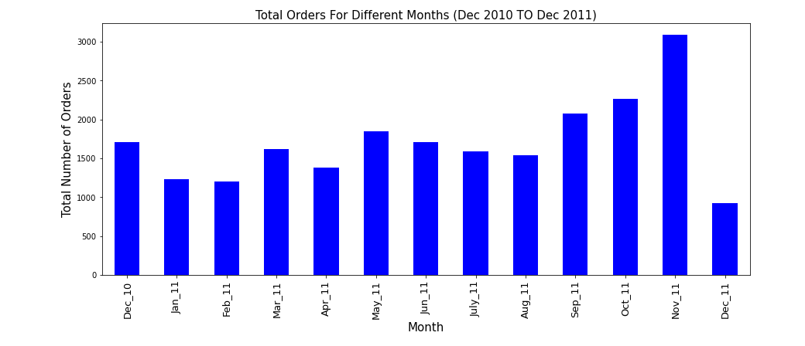
The most and least profitable month in terms of sales? November 2011 has the highest sale and December 2011 has lowest sale

Slide 7
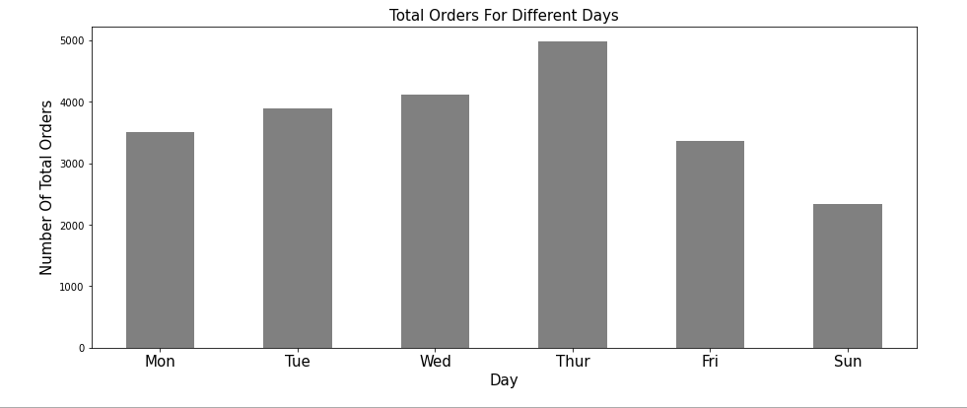
Which day saw the majority of orders placed? By looking at the graph below, we can observe that there were more orders on Thursday’s.

Slide 8
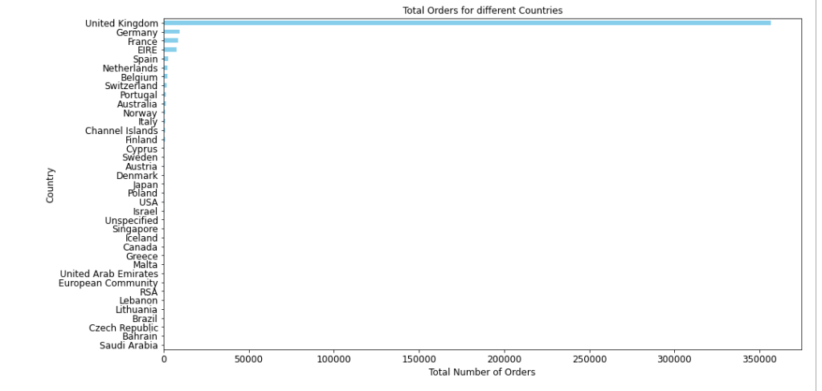
What country is placing the most orders? United Kingdom (UK), has placed more orders.

Slide 9
THANK YOU

